Slide 1

Machine Learning with scikit-learn
Andreas Mueller (NYU Center for Data Science, co-release manager scikit-learn)
http://bit.ly/skCUNY
http://bit.ly/skCUNY

Slide 2



Me

Slide 3
What is scikit-learn?

Slide 4
Classification
Regression
Clustering
Semi-Supervised Learning
Feature Selection
Feature Extraction
Manifold Learning
Dimensionality Reduction
Kernel Approximation
Hyperparameter Optimization
Evaluation Metrics
Out-of-core learning
…...

Slide 5

http://scikit-learn.org/

Slide 6
What is machine learning?

Slide 7
Hi Andy,
I just received an email from the first tutorial speaker, presenting right before you, saying he's ill and won't be able to make it.
I know you have already committed yourself to two presentations, but is there anyway you could increase your tutorial time slot, maybe just offer time to try out what you've taught? Otherwise I have to do some kind of modern dance interpretation of Python in data :-)
-Leah
Hi Andreas,
I am very interested in your Machine Learning background. I work for X Recruiting who have been engaged by Z, a worldwide leading supplier of Y. We are expanding the core engineering team and we are looking for really passionate engineers who want to create their own story and help millions of people.
Can we find a time for a call to chat for a few minutes about this?
Thanks

Slide 8


Hi Andy,
I just received an email from the first tutorial speaker, presenting right before you, saying he's ill and won't be able to make it.
I know you have already committed yourself to two presentations, but is there anyway you could increase your tutorial time slot, maybe just offer time to try out what you've taught? Otherwise I have to do some kind of modern dance interpretation of Python in data :-)
-Leah
Hi Andreas,
I am very interested in your Machine Learning background. I work for X Recruiting who have been engaged by Z, a worldwide leading supplier of Y. We are expanding the core engineering team and we are looking for really passionate engineers who want to create their own story and help millions of people.
Can we find a time for a call to chat for a few minutes about this?
Thanks

Slide 9
Doing Machine Learning With Scikit-Learn

Slide 10
Representing Data
one sample
1.1 | 2.2 | 3.4 | 5.6 | 1.0
6.7 | 0.5 | 0.4 | 2.6 | 1.6
2.4 | 9.3 | 7.3 | 6.4 | 2.8
1.5 | 0.0 | 4.3 | 8.3 | 3.4
0.5 | 3.5 | 8.1 | 3.6 | 4.6
5.1 | 9.7 | 3.5 | 7.9 | 5.1
3.7 | 7.8 | 2.6 | 3.2 | 6.3
1.6
2.7
4.4
0.5
0.2
5.6
6.7
X =
y =
one feature
outputs / labels

Slide 11
Training and Testing Data
training set
1.1 | 2.2 | 3.4 | 5.6 | 1.0
6.7 | 0.5 | 0.4 | 2.6 | 1.6
2.4 | 9.3 | 7.3 | 6.4 | 2.8
1.5 | 0.0 | 4.3 | 8.3 | 3.4
0.5 | 3.5 | 8.1 | 3.6 | 4.6
5.1 | 9.7 | 3.5 | 7.9 | 5.1
3.7 | 7.8 | 2.6 | 3.2 | 6.3
1.6
2.7
4.4
0.5
0.2
5.6
6.7
X =
y =
test set
from sklearn.cross_validation import train_test_split
X_train, X_test, y_train, y_test = train_test_split(X, y)

Slide 12
Supervised Machine Learning
Training Data
Model
Training
Training Labels
Test Data
Prediction
Generalization
Test Labels
Evaluation

Slide 13
clf = RandomForestClassifier()
clf.fit(X_train, y_train)
Training Data
Model
Training Labels
y_pred = clf.predict(X_test)
Test Data
Prediction
Test Labels
Evaluation
clf.score(X_test, y_test)

Slide 14
Unsupervised Machine Learning
Training Data
Model
Test Data
New View

Slide 15
Unsupervised Transformations
pca = PCA()
pca.fit(X_train)
X_new = pca.transform(X_test)
Training Data
Model
Test Data
Transformation

Slide 16
Basic API
estimator.fit(X, [y])
estimator.predict | estimator.transform
Classification | Preprocessing
Regression | Dimensionality reduction
Clustering | Feature selection
 | Feature extraction

Slide 17
Sample application: Sentiment Analysis

Slide 18
IMDB Movie Reviews Data
Review:
One of the worst movies I've ever rented. Sorry it had one of my favorite actors on it (Travolta) in a nonsense role. In fact, anything made sense in this movie.
Who can say there was true love between Eddy and Maureen? Don't you remember the beginning of the movie ?
Is she so lovely? Ask her daughters. I don't think so.
Label: negative
Training data: 12500 positive, 12500 negative

Slide 19
Bag Of Word Representations
CountVectorizer / TfidfVectorizer
“This is how you get ants.”
tokenizer
['this', 'is', 'how', 'you', 'get', 'ants']
Build a vocabulary over all documents
['aardvak', 'amsterdam', 'ants', ... 'you', 'your', 'zyxst']
Sparse matrix encoding
aardvak
ants
get
you
zyxst
[0, …, 0, 1, 0, … , 0, 1 , 0, …, 0, 1, 0, …., 0 ]

Slide 20
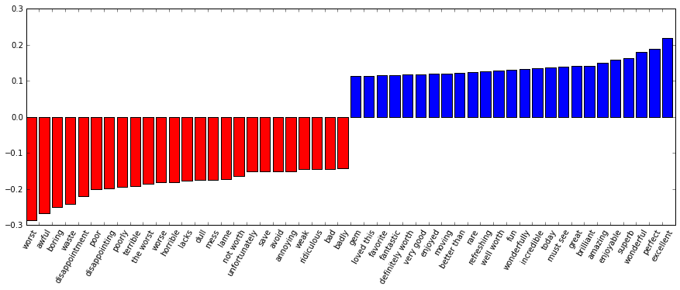
Implementation and Results
text_pipe = make_pipeline(CountVectorizer(), LinearSVC())
clf.fit(X_train, y_train)
clf.score(X_test, y_test)
> 0.85

Slide 21
Model Complexity

Slide 22
Overfitting and Underfitting
Training
Sweet spot
Accuracy
Generalization
Underfitting
Overfitting
Model complexity

Slide 23
Model Complexity Examples

Slide 24

Linear SVM

Slide 25


(RBF) Kernel SVM

Slide 26











Decision Trees

Slide 27




Random Forests

Slide 28
Model Evaluation and Model Selection

Slide 29
All Data
Training data
Test data
Fold 1
Fold 2
Fold 3
Fold 4
Fold 5
Split 1
Fold 1
Fold 2
Fold 3
Fold 4
Fold 5
Split 2
Fold 1
Fold 2
Fold 3
Fold 4
Fold 5
Split 3
Fold 1
Fold 2
Fold 3
Fold 4
Fold 5
Split 4
Fold 1
Fold 2
Fold 3
Fold 4
Fold 5
Split 5
Fold 1
Fold 2
Fold 3
Fold 4
Fold 5

Slide 30
Cross-Validation
from sklearn.cross_validation import cross_val_score
scores = cross_val_score(SVC(), X, y, cv=5)
print(scores)
>> [ 0.92 1. 1. 1. 1. ]

Slide 31
SVC(C=0.001, gamma=0.001)
SVC(C=0.01, gamma=0.001)
SVC(C=0.1, gamma=0.001)
SVC(C=1, gamma=0.001)
SVC(C=10, gamma=0.001)
SVC(C=0.001, gamma=0.01)
SVC(C=0.01, gamma=0.01)
SVC(C=0.1, gamma=0.01)
SVC(C=1, gamma=0.01)
SVC(C=10, gamma=0.01)
SVC(C=0.001, gamma=0.1)
SVC(C=0.01, gamma=0.1)
SVC(C=0.1, gamma=0.1)
SVC(C=1, gamma=0.1)
SVC(C=10, gamma=0.1)
SVC(C=0.001, gamma=1)
SVC(C=0.01, gamma=1)
SVC(C=0.1, gamma=1)
SVC(C=1, gamma=1)
SVC(C=10, gamma=1)
SVC(C=0.001, gamma=10)
SVC(C=0.01, gamma=10)
SVC(C=0.1, gamma=10)
SVC(C=1, gamma=10)
SVC(C=10, gamma=10)

Slide 32
All Data
Training data
Test data
Fold 1
Fold 2
Fold 3
Fold 4
Fold 5
Split 1
Fold 1
Fold 2
Fold 3
Fold 4
Fold 5
Split 2
Fold 1
Fold 2
Fold 3
Fold 4
Fold 5
Finding Parameters
Split 3
Fold 1
Fold 2
Fold 3
Fold 4
Fold 5
Split 4
Fold 1
Fold 2
Fold 3
Fold 4
Fold 5
Split 5
Fold 1
Fold 2
Fold 3
Fold 4
Fold 5
Final evaluation
Test data

Slide 33
Cross -Validated Grid Search
from sklearn.grid_search import GridSearchCV
from sklearn.cross_validation import train_test_split
X_train, X_test, y_train, y_test = train_test_split(X, y)
param_grid = {'C': 10. ** np.arange(-3, 3),
'gamma': 10. ** np.arange(-3, 3)}
grid = GridSearchCV(SVC(), param_grid=param_grid)
grid.fit(X_train, y_train)
grid.score(X_test, y_test)

Slide 34
Pipelines

Slide 35
Training Labels
Training Data
Model

Slide 36
Training Labels
Training Data
Feature
Extraction
Scaling
Feature
Selection
Model
Cross Validation and Parameter selection

Slide 37
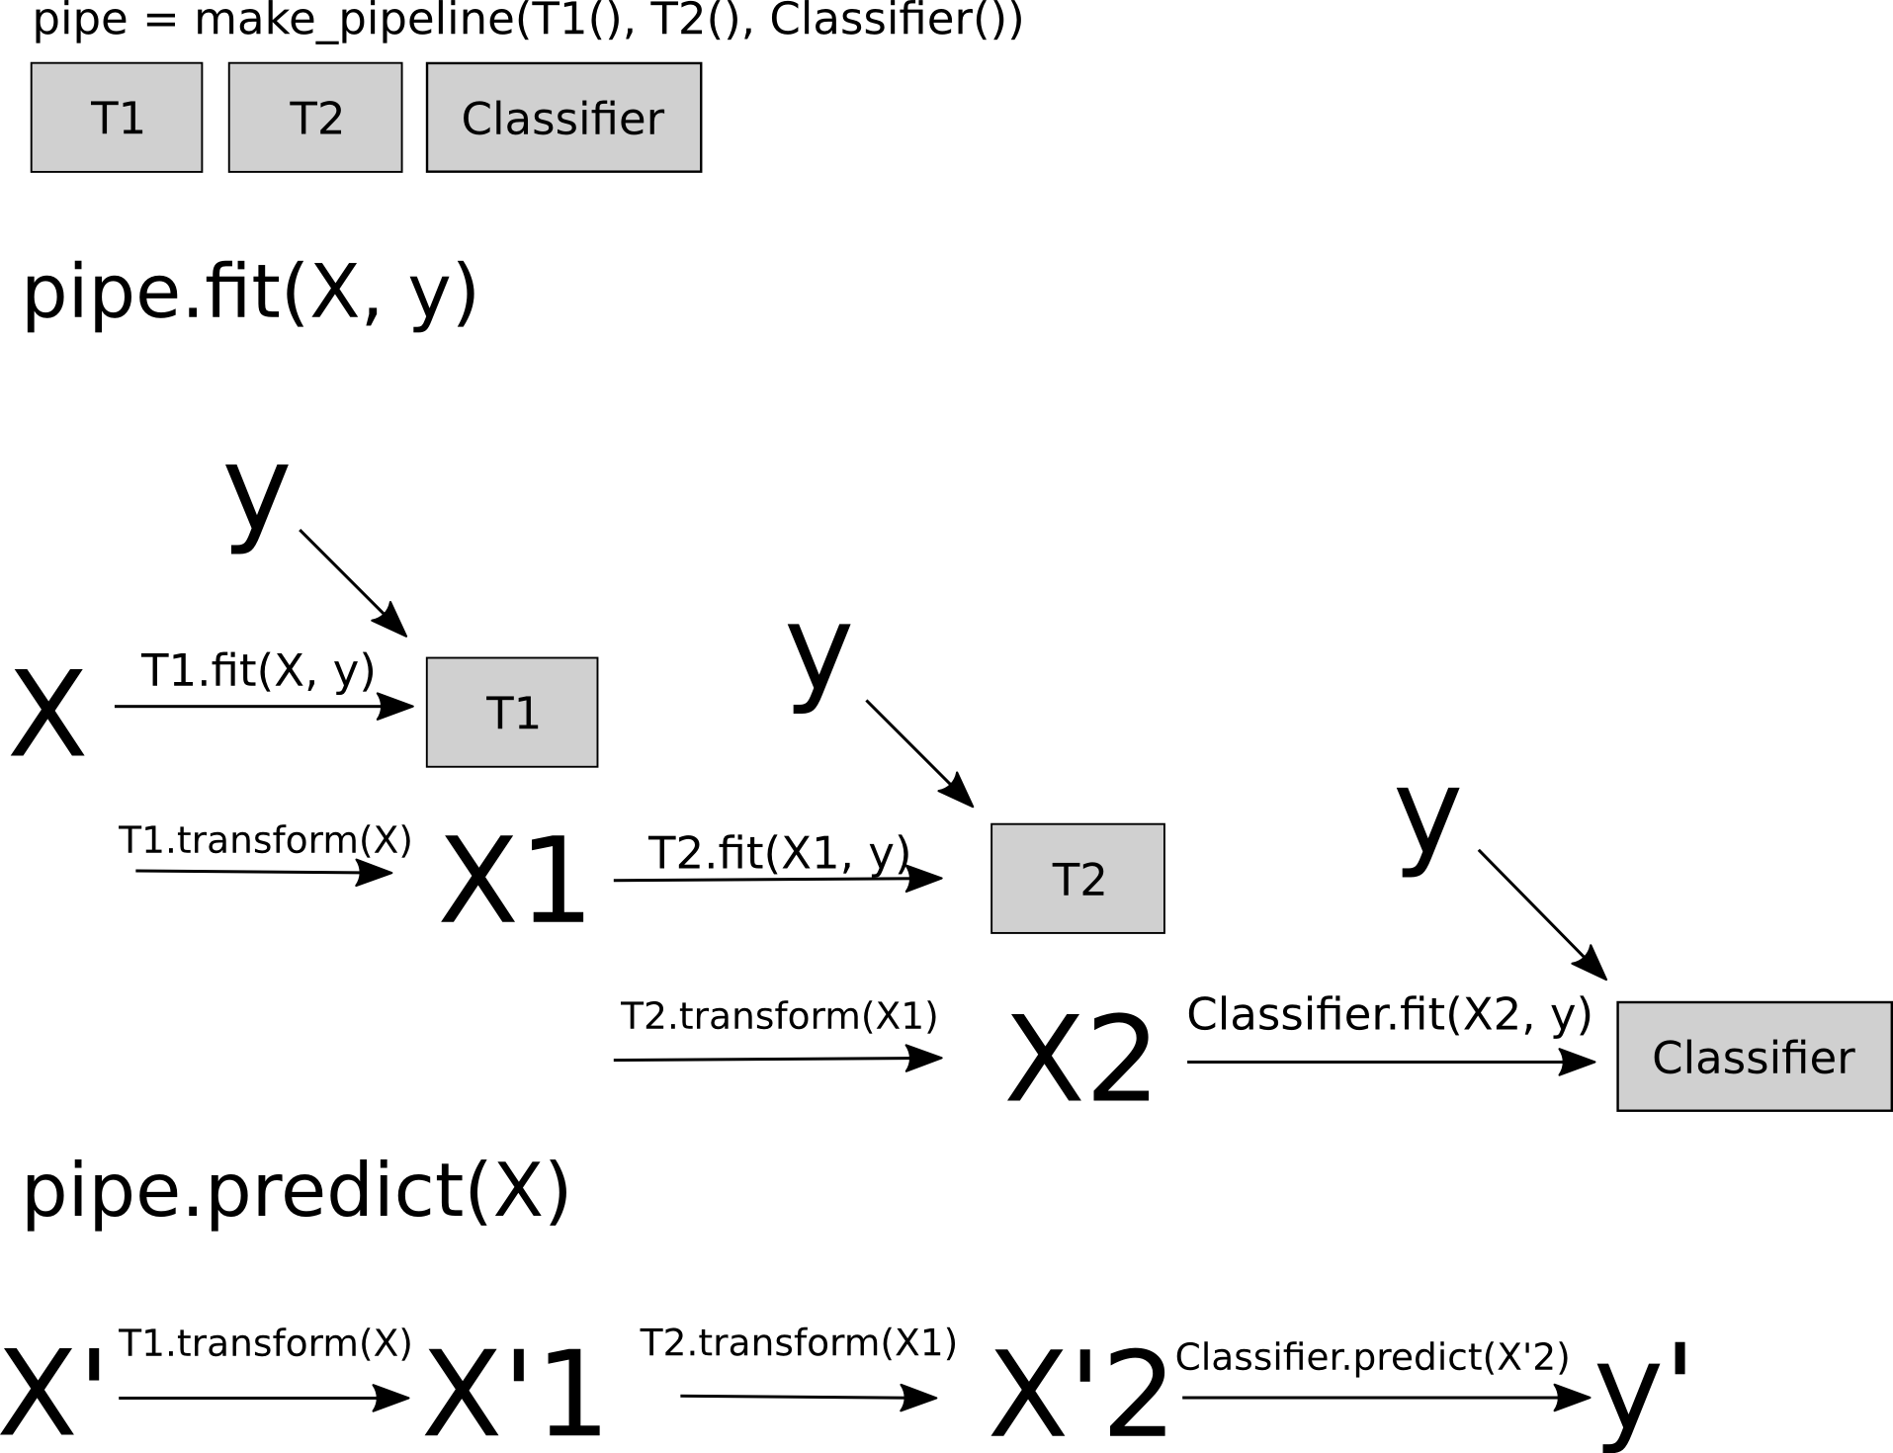
Pipelines
from sklearn.pipeline import make_pipeline
pipe = make_pipeline(StandardScaler(), SVC())
pipe.fit(X_train, y_train)
pipe.predict(X_test)

Slide 38
Combining Pipelines and
Grid Search
Proper cross-validation
param_grid = {'svc__C': 10. ** np.arange(-3, 3),
'svc__gamma': 10. ** np.arange(-3, 3)}
scaler_pipe = make_pipeline(StandardScaler(), SVC())
grid = GridSearchCV(scaler_pipe, param_grid=param_grid, cv=5)
grid.fit(X_train, y_train)

Slide 39
Combining Pipelines and
Grid Search II
Searching over parameters of the preprocessing step
param_grid = {'selectkbest__k': [1, 2, 3, 4],
'svc__C': 10. ** np.arange(-3, 3),
'svc__gamma': 10. ** np.arange(-3, 3)}
scaler_pipe = make_pipeline(SelectKBest(), SVC())
grid = GridSearchCV(scaler_pipe, param_grid=param_grid, cv=5)
grid.fit(X_train, y_train)

Slide 40
Do cross-validation over all steps jointly.
Keep a separate test set until the very end.

Slide 41
Scoring Functions

Slide 42
GridSeachCV
cross_val_score
Default:
Accuracy (classification)
R2 (regression)
For GridSeachCV
cross_val_score
validation_curve
Typical: accuracy

Slide 43

Scoring with imbalanced data
cross_val_score(SVC(), X_train, y_train)
>>> array([ 0.9, 0.9, 0.9])
cross_val_score(DummyClassifier("most_frequent"), X_train, y_train)
>>> array([ 0.9, 0.9, 0.9])
cross_val_score(SVC(), X_train, y_train, scoring="roc_auc")
>>> array([ 1,0, 1.0, 1,0])

Slide 44

Video Series
Advanced Machine Learning with scikit-learn
Coupon: XXX FIXME

Slide 45

CDS is hiring Research Engineers
Work on your favorite data science open source project full time!

Slide 46




Thank you for your attention.
@t3kcit
@amueller
importamueller@gmail.com
http://amueller.github.io

